Slide 1
Regression
Vanessa LoBue
Jamil Bhanji
with a little help from Andy Field

Slide 2
Aims
Understand the linear model and its assumptions
Understand how we assess the fit of the model
Understand how we interpret model parameters
Understand how to assess the generalizability of the model
Fit and interpret linear models using IBM SPSS Statistics

Slide 3
What is the Linear Model?
A way of predicting the value of one variable from another.
It is a hypothetical model of the relationship between two variables.
The model used is a linear one.
Therefore, we describe the relationship using the equation of a straight line.

Slide 4
Describing a Straight Line
$${\text{y}}_{i}=\left(b_{0}+b_{1}X_{i}\right)+{\text{ε}}_{i}$$
b_{i}
Coefficient for the predictor
Gradient (slope) of the line
Direction/strength of relationship
b₀
Intercept (value of Y when X = 0)
Point at which the regression line crosses the Y-axis (ordinate)

Slide 5
Intercepts and Gradients

Slide 6
A Musical Example
A record company boss was interested in predicting album sales from advertising.
Data
200 different album releases
Outcome variable:
Sales (CDs and Downloads) in the week after release
Predictor variables
The amount (in £s) spent promoting the album before release
Number of plays on the radio
Image of the band

Slide 7
Linear Model with One Predictor

Slide 8
Linear Model with Two Predictors

Slide 9
The Model as an Equation
With several predictors the model is described using a variation of the equation of a straight line.
$$Y_{i}=\left(b_{0}+b_{1}X_{1i}+b_{2}X_{2i}+⋯+b_{n}X_{ni}\right)+ε_{i}$$
Notes:
A similar equation can be derived in which each predictor variable has its own coefficient, and the outcome variable is predicted from a combination of all the variables multiplied by their respective coefficients plus a residual term (see equation above).
Y is the outcome variable, β₁ is the coefficient of the first predictor (X₁), β₂ is the coefficient of the second predictor (X₂), β_{n} is the coefficient of the n^{th} predictor (X_{n}), and ε_{i} is the difference between the predicted and the observed value of Y for the i^{th} subject. In this case, the model fitted is more complicated, but the basic principle is the same as simple regression. That is, we seek to find the linear combination of predictors that correlate maximally with the outcome variable.

Slide 10
b₀
b₀ is the intercept.
The intercept is the value of the Y variable when all Xs = 0.
This is the point at which the model plane crosses the Y-axis (vertical).

Slide 11
Beta Values
b₁ is the coefficient for variable 1.
b₂ is the coefficient for variable 2.
b_{n} is the coefficient for n^{th} variable.

Slide 12
Estimation: the Method of Least Squares
$$\text{Total} \text{error}= \sum_{i=1}^{n}{{\left({observed}_{i}−{model}_{i}\right)}^{2}}$$

Slide 13
The Fit of the Model?
The model based on the data might not reflect reality.
We need some way of testing how well the model fits the observed data.
How?
F
R²

Slide 14
Sums of squares

Slide 15
Summary
SS_{T}
Total variability (variability between scores and the mean).
SS_{R}
Residual/error variability (variability between the model and the actual data).
SS_{M}
Model variability (difference in variability between the model and the mean).

Slide 16
Testing the Fit: F-statistic
SS_{T}
Total variance in the data
SS_{M}
SS_{R}
Improvement due to the model
Error in the model
If the model results in better prediction than using the mean, then we expect SS_{M} to be much greater than SS_{R}

Slide 17
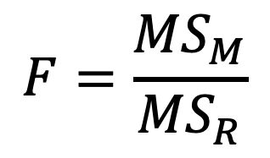
Testing the Fit: F-statistic
Mean Squared Error
Sums of Squares are total values.
They can be expressed as averages.
These are called Mean Squares, MS
$$F=\frac{{MS}_{M}}{{MS}_{R}}$$

Slide 18
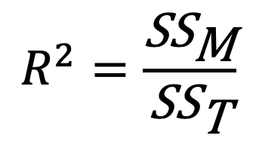
Testing the Fit: R²
R²
The proportion of variance accounted for by the regression model.
The Pearson correlation coefficient squared
$$R^{2}=\frac{{\text{SS}}_{\text{M}}}{{\text{SS}}_{\text{T}}}$$

Slide 19
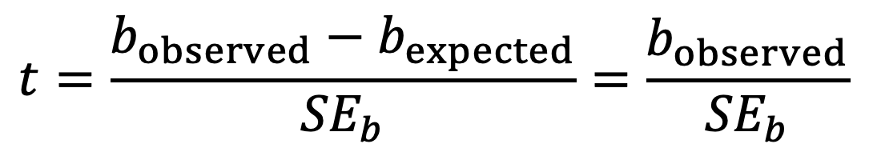
Individual Predictors
$$t=\frac{b_{observed}−b_{expected}}{{SE}_{b}}=\frac{b_{observed}}{{SE}_{b}}$$

Slide 20
Building the Model: Hierarchical Entry
Known predictors (based on past research) are entered into the regression model first
New predictors are then entered in a separate step/block
Researcher makes the decisions

Slide 21
Hierarchical Entry
It is the best method:
Based on theory testing.
You can see the unique predictive influence of a new variable on the outcome because known predictors are held constant in the model.
Bad point:
It relies on the researcher knowing what they’re doing!

Slide 22
Forced Entry
All variables are entered into the model simultaneously.
The results obtained depend on the variables entered into the model.
It is important, therefore, to have good theoretical reasons for including a particular variable.

Slide 23
Stepwise entry
Variables are entered into the model based on mathematical criteria.
Computer selects variables in steps.
Step 1
SPSS looks for the predictor that can explain the most variance in the outcome variable.

Slide 24
Stepwise Entry
Step 2:
Having selected the 1st predictor, a second one is chosen from the remaining predictors.
The semi-partial correlation (think back to the last lecture) is used as a criterion for selection.

Slide 25
Problems with Stepwise Entry
Reliance on a mathematical criterion
Variable selection may depend upon only slight differences in the semi-partial correlation
These slight numerical differences can lead to major theoretical differences
Should be used only for exploration

Slide 26
Bias: Outliers

Slide 27
Bias: Influential Cases

Slide 28
How well does the model fit the data?
There are two ways to assess the accuracy of the model in the sample:
Residual statistics
Standardized residuals
Influential cases
Cook’s distance

Slide 29
Standardized Residuals
In an average sample, 95% of standardized residuals should lie between ± 2.
99% of standardized residuals should lie between ± 2.5.
Outliers
Any case for which the absolute value of the standardized residual is 3 or more, is likely to be an outlier.

Slide 30
Generalizing the model
We hope to be able to generalize the sample model to the entire population.
To do this, several assumptions must be met (Chapter 6).
Violating these assumptions stops us generalizing conclusions to our target population.

Slide 31
Straightforward Assumptions
Variable type:
Outcome must be continuous
Predictors can be continuous or dichotomous.
Non-zero variance:
Predictors must not have zero variance.
Linearity:
The relationship we model is, in reality, linear.
Independence:
All values of the outcome should come from a different person.

Slide 32
Assumptions that Matter (in order)
Additivity and linearity
Spherical residuals
Homoscedasticity: For each value of the predictors the variance of the error term should be constant
Independent residuals: for any pair of observations, the error terms should be uncorrelated.
Normally-distributed errors
No Multicollinearity:
Predictors must not be highly correlated.

Slide 33
Checking Assumptions about Errors
Homoscedacity/Independence of errors:
Plot ZRESID against ZPRED.
Normality of errors:
Normal probability plot.

Slide 34
Multicollinearity
Multicollinearity exists if predictors are highly correlated.
This assumption can be checked with collinearity diagnostics.
Tolerance should be more than 0.2 (Menard, 1995)
VIF should be less than 10 (Myers, 1990)

Slide 35
The Record Sales Example
A record company boss was interested in predicting album sales from advertising.
Data
200 different album releases
Outcome variable:
Sales (CDs and Downloads) in the week after release
Predictor variables
The amount (in £s) spent promoting the album before release
Number of plays on the radio
Image of the band

Slide 37
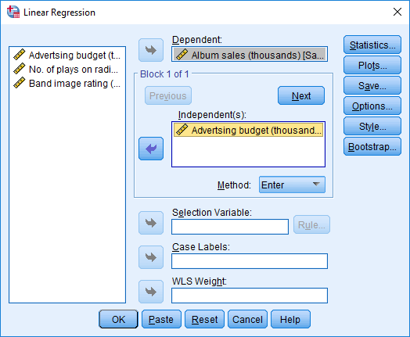
A Model with One Predictor

Slide 38
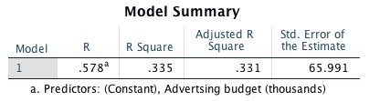
Model Summary

Slide 39
F-statistic

Slide 40
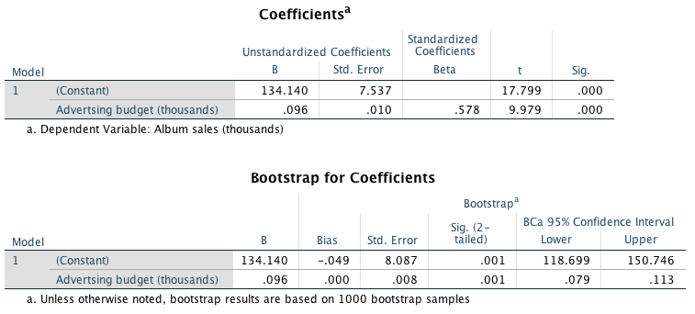
Model Parameters

Slide 41
Using the Model

Slide 42
A Model with Several Predictors

Slide 43
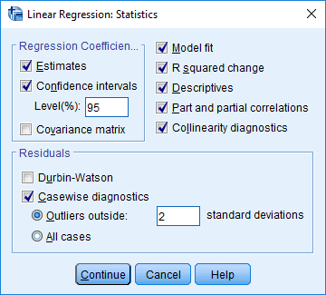
Statistics

Slide 44
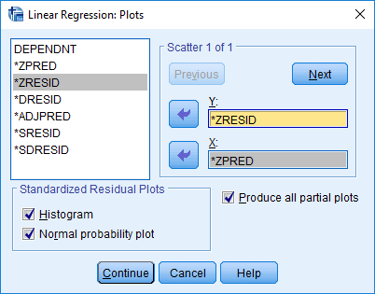
Plots

Slide 45
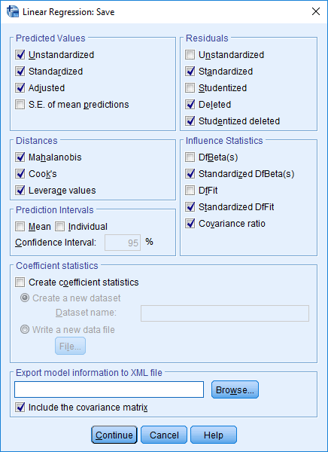
Diagnostics

Slide 46
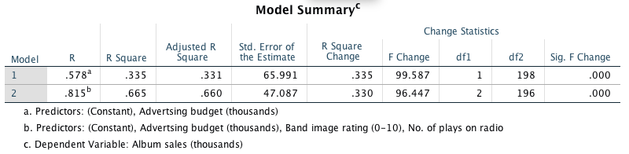
Model Summary

Slide 47
R and R²
R
The correlation between the observed values of the outcome, and the values predicted by the model.
R²
The proportion of variance accounted for by the model.
Adj. R²
An estimate of R² in the population (shrinkage).

Slide 48
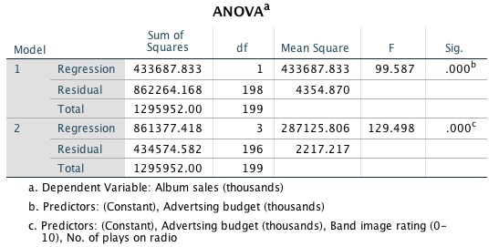
F-statistics

Slide 49
F-statistic
Looks at whether the variance explained by the model (SS_{M}) is significantly greater than the error within the model (SS_{R})
It tells us whether using the regression model is significantly better at predicting values of the outcome than using the mean

Slide 50
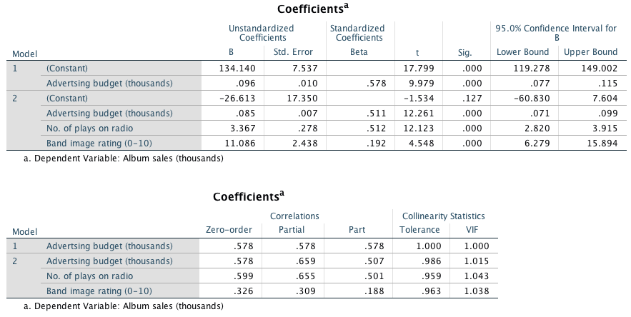
Model Parameters

Slide 51
Interpreting Model Parameters
b-values:
The change in the outcome associated with a unit change in the predictor.
Standardised b-values :
Tell us the same but expressed as standard deviations.

Slide 52
b-values
Advertising budget: b = 0.085
As advertising budget increases by one unit, album sales increase by 0.085 units. Both variables were measured in thousands; therefore, for every £1000 more spent on advertising, an extra 0.085 thousand albums (85 albums) are sold. This interpretation is true only if the effects of band image and airplay are held constant.
Airplay: b = 3.367
As the number of plays on radio in the week before release increases by one, album sales increase by 3.367 units. Every additional play of a song on radio (in the week before release) is associated with an extra 3.367 thousand albums (3367 albums) being sold. This interpretation is true only if the effects of the band’s image and advertising budget are held constant.
Image: b = 11.086
If a band can increase their image rating by 1 unit they can expect additional album sales of 11.086 units. Every unit increase in the band’s image rating is associated with an extra 11.086 thousand albums (11,086 albums) being sold. This interpretation is true only if the effects of airplay and advertising are held constant.

Slide 53
Standardised beta values
Advertising budget: Standardized β = 0.511
As advertising budget increases by one standard deviation (£485,655), album sales increase by 0.511 standard deviations (41,240 sales). This interpretation is true only if the effects of the band’s image and airplay are held constant.
Airplay: Standardized β = 0.512
As the number of plays on radio in the week before release increases by 1 standard deviation (12.27), album sales increase by 0.512 standard deviations (41,320 sales). This interpretation is true only if the effects of the band’s image and advertising are held constant.
Image: Standardized β = 0.192
A band rated one standard deviation (1.40 units) higher on the image scale can expect additional album sales of 0.192 standard deviations units (15,490 sales). This interpretation is true only if the effects of airplay and advertising are held constant.

Slide 54
Collinearity

Slide 55
Logistic Regression
To predict an outcome variable that is categorical from one or more categorical or continuous predictor variables
Used because having a categorical outcome variable violates the assumption of linearity in normal regression

Slide 56
With One Predictor
$$P\left(Y\right)=\frac{1}{1+e^{−\left(b_{0}+b_{1}X_{1i}\right)}}$$
Outcome
We predict the probability of the outcome occurring
b₀ and b₁
Can be thought of in much the same way as the linear model
Note the linear model equation forms part of the logistic regression equation

Slide 57
With Several Predictors
$$P\left(Y\right)=\frac{1}{1+e^{−\left(b_{0}+b_{1}X_{1i}+b_{2}X_{2i}+⋯+b_{n}X_{ni}\right)}}$$
Outcome
We still predict the probability of the outcome occurring
Differences
Note the linear model equation forms part of the logistic regression equation
This part of the equation expands to accommodate additional predictors

Slide 58
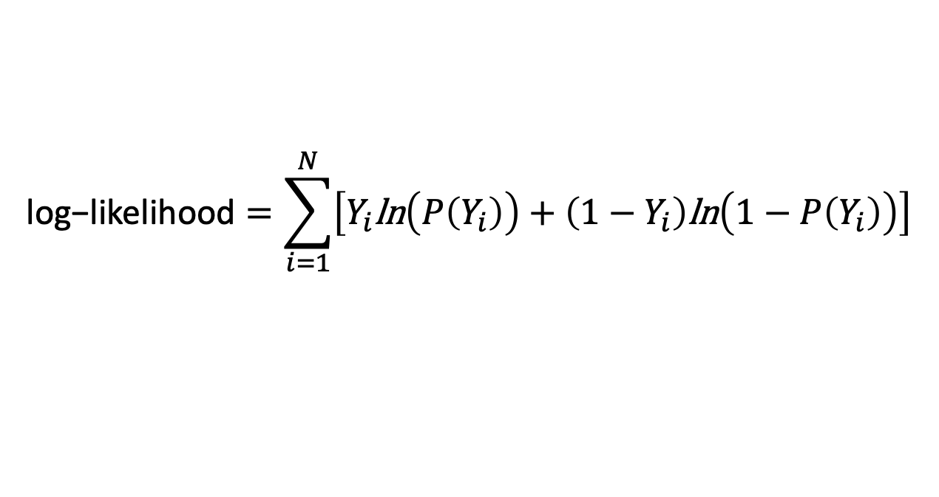
The log-likelihood
$$\text{log}\text{−}\text{likelihood}=\sum_{i=1}^{N}{\left[Y_{i}\text{ln}\left(P\left(Y_{i}\right)\right)+\left(1−Y_{i}\right)\text{ln}\left(1−P\left(Y_{i}\right)\right)\right]}$$
The Log-likelihood statistic
Analogous to the residual sum of squares in the linear model
It is an indicator of how much unexplained information there is after the model has been fitted.
Large values indicate poorly fitting statistical models.

Slide 59
The deviance statistic
The deviance is very closely related to the log-likelihood: it’s given by
Deviance = −2LL
It’s possible to calculate a log-likelihood or deviance for different models and to compare these models by looking at the difference between their deviances.

Slide 60
R and R²
This R-statistic
is the partial correlation between the outcome variable and each of the predictor variables.
It can vary between −1 and 1.
The R-statistic is given by:
Or:

Slide 61
The Wald Statistic
$$z=\frac{b}{{SE}_{b}}$$
Similar to t-statistic in the linear model
Tests the null hypothesis that b = 0
Is biased when b is large.
Better to look at likelihood-ratio statistics.

Slide 62
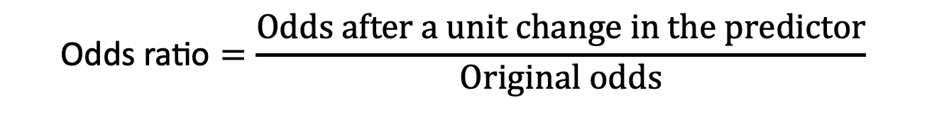
The odds ratio, exp(B)
$$\text{Odds} \text{ratio}=\frac{Odds after a unit change in the predictor}{Original odds}$$
Indicates the change in odds resulting from a unit change in the predictor.
OR > 1: Predictor ↑, Probability of outcome occurring ↑.
OR < 1: Predictor ↑, Probability of outcome occurring ↓.

Slide 63
Building the Model
Forced entry: all variables entered simultaneously.
Hierarchical: variables entered in blocks.
Blocks should be based on past research, or theory being tested. Good method.
Stepwise: variables entered on the basis of statistical criteria (i.e., Relative contribution to predicting outcome).
Should be used only for exploratory analysis.

Slide 64
Model Building and Parsimony
When building a model we should strive for parsimony.
predictors should not be included unless they have explanatory benefit
First fit the model that includes all potential predictors, and then systematically remove any that don’t seem to contribute to the model

Slide 65
Things that can go wrong
Assumptions from Linear Regression:
Linearity
Independence of Errors
Multicollinearity
Unique Problems
Incomplete Information
Complete Separation
Overdispersion

Slide 66
Incomplete Information From the Predictors
Categorical Predictors:
Predicting cancer from smoking and eating tomatoes.
We don’t know what happens when nonsmokers eat tomatoes because we have no data in this cell of the design.
Continuous variables
Will your sample contain a to include an 80 year old, highly anxious, Buddhist left-handed lesbian?

Slide 67
Complete Separation
When the outcome variable can be perfectly predicted
E.g. predicting whether someone is a burglar, your teenage son or your cat based on weight
Weight is a perfect predictor of cat/burglar unless you have a very fat cat indeed!

Slide 68
Overdispersion
When the outcome contains more than two categories
Overdispersion is where the variance is larger than expected from the model
This can be caused by violating the assumption of independence
This problem makes the standard errors too small.

Slide 69
The Process

Slide 70
An Example
Predictors of a treatment intervention.
Participants
113 adults with a medical problem
Outcome:
Cured (1) or not cured (0).
Predictors:
Intervention: intervention or no treatment.
Duration: the number of days before treatment that the patient had the problem.

Slide 71
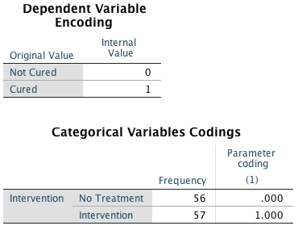
Output

Slide 72
Output: Initial Analysis

Slide 73
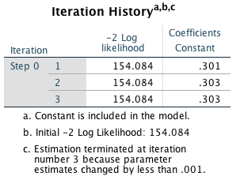
Output: Block 0

Slide 74
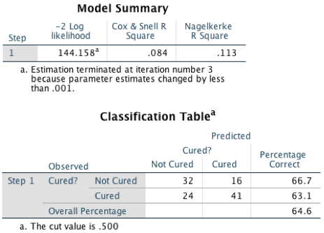
Output: Model Summary

Slide 75
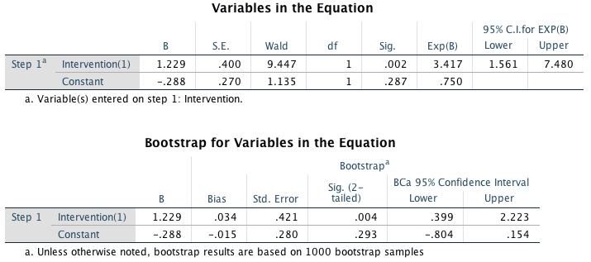
Model Parameters

Slide 76
Model Summary

Slide 77
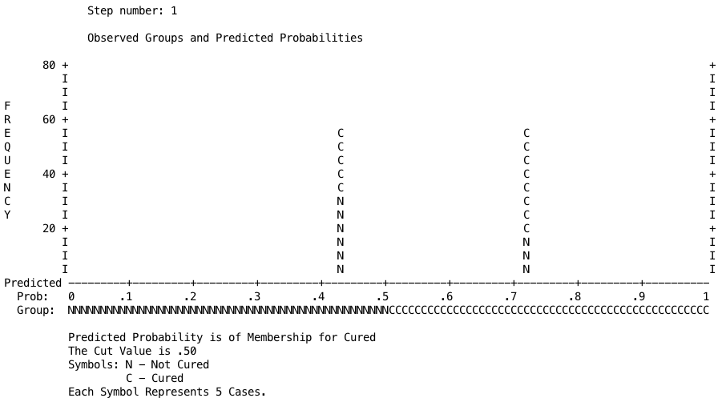
Classification Plot

Slide 78
Summary
The overall fit of the final model is shown by −2LL and its associated chi-square statistic.
If the significance of the chi-square statistic is less than .05, then the model is a significant fit of the data.
Check the table labelled Variables in the equation to see the regression parameters for any predictors in the model.
Look at the Wald statistic and its significance.
Use the odds ratio, exp(B), for interpretation.
OR > 1, then as the predictor increases, the odds of the outcome occurring increase.
OR < 1, then as the predictor increases, the odds of the outcome occurring decrease.
The confidence interval of Exp(B) should not cross 1.

Slide 79
Multinomial logistic regression
Logistic regression to predict membership of more than two categories.
It (basically) works in the same way as binary logistic regression.
The analysis breaks the outcome variable down into a series of comparisons between two categories.
E.g., if you have three outcome categories (A, B and C), then the analysis will consist of two comparisons that you choose:
Compare everything against your first category (e.g. A vs. B and A vs. C),
Or your last category (e.g. A vs. C and B vs. C),
Or a custom category (e.g. B vs. A and B vs. C).
The important parts of the analysis and output are much the same as we have just seen for binary logistic regression

Slide 80
I may not be Fred Flintstone …
How successful are chat-up lines?
The chat-up lines used by 348 men and 672 women in a night-club were recorded.
Outcome:
Whether the chat-up line resulted in one of the following three events:
The person got no response or the recipient walked away,
The person obtained the recipient’s phone number,
The person left the night-club with the recipient.
Predictors:
The content of the chat-up lines were rated for:
Funniness (0 = not funny at all, 10 = the funniest thing that I have ever heard)
Sexuality (0 = no sexual content at all, 10 = very sexually direct)
Moral vales (0 = the chat-up line does not reflect good characteristics, 10 = the chat-up line is very indicative of good characteristics).
Gender of recipient

Slide 81
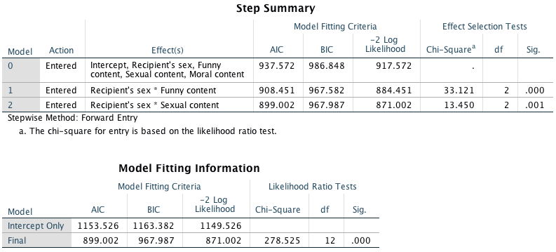
Output I

Slide 82
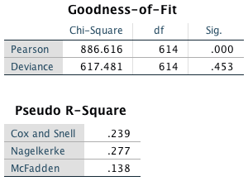
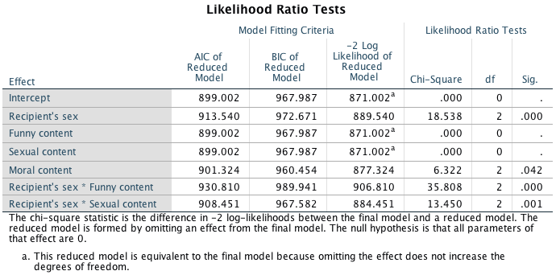

Slide 83
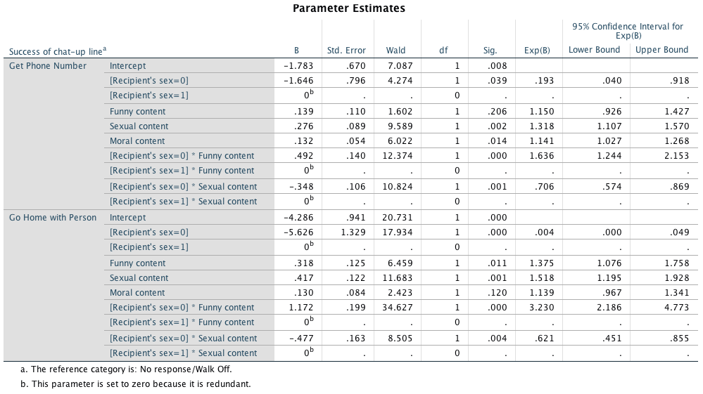
Output III

Slide 84
Interpretation I
Moral: Whether the chat-up line showed signs of good moral fibre did not significantly predict whether you went home with the date or got a slap in the face, b = 0.13, Wald χ²(1) = 2.42, p = .120.
Funny: Whether the chat-up line was funny significantly predicted whether you went home with the date or no response, b = 0.32, Wald χ²(1) = 6.46, p = .011.
Recipient_Sex: The sex of the person being chatted up significantly predicted whether they went home with the person or gave no response, b = −5.63, Wald χ²(1) = 17.93, p < .001.
Sex: The sexual content of the chat-up line significantly predicted whether you went home with the date or got a slap in the face, b = 0.42, Wald χ²(1) = 11.68, p = .001.

Slide 85
Interpretation II
Funny × Recipient_Sex: The success of funny chat-up lines depended on whether they were delivered to a man or a woman because in interaction these variables predicted whether or not you went home with the date, b = 1.17, Wald χ²(1) = 34.63, p < .001.
Sex × Recipient_Sex: The success of chat-up lines with sexual content depended on whether they were delivered to a man or a woman because in interaction these variables predicted whether or not you went home with the date, b = −0.48, Wald χ²(1) = 8.51, p = .004.

